Slide 1
Personnel Development Program Data Collection System (PDPDCS)
Continuing Grantees Webinar
Celia Rosenquist, OSEP
Michelle Bloom, OSEP Program Coordinator
Emily Hare, OSEP Program Coordinator Support
January 29, 2026

Slide 2
Training Agenda
Annual PDPDCS data collection requirements
Entering and updating scholar records
Exiting scholar records
Avoiding security incidents
Information to share with OSEP scholars
Additional resources and support

Slide 3
PDPDCS Grantees
PDPDCS by the Numbers (2025)
Active Grants | 386
Unique Grantees | 159
Active Scholars | 7,217
Total Funding Disbursed to Scholars | $181.6 million
Scholars Currently Fulfilling Service Obligation | 2,147

Slide 4
Annual Data Collection Requirements

Slide 5
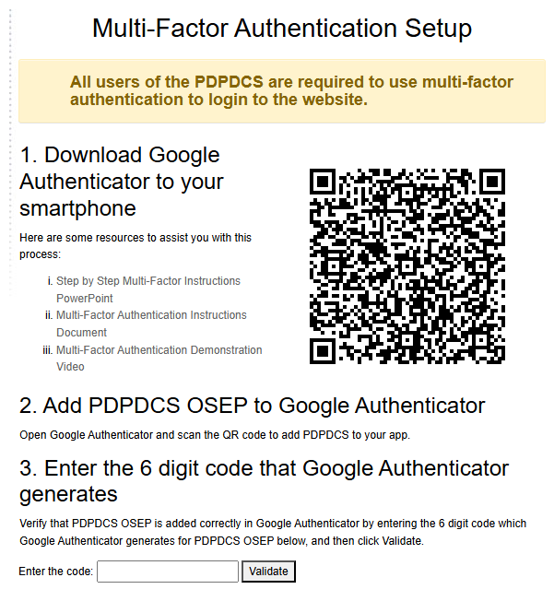

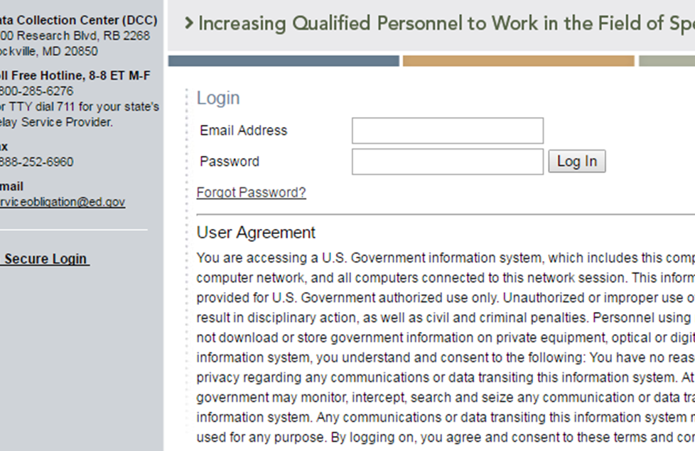
Password Reset and MFA
Use the “Forgot Password” link on
the login page to reset your password.
Click the resources links if you need additional help with MFA.

Slide 6
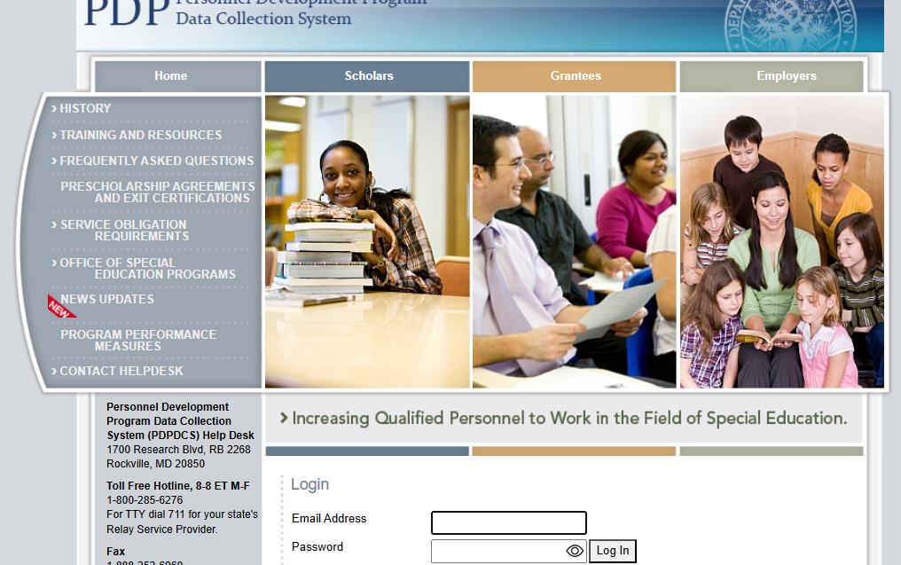
Overview of Data Collection Steps
Complete by March 13th
Log into the PDPDCS and verify the secondary user(s)
Review your data summary
Add any newly enrolled scholars
Update scholar record for each enrolled or enrolled, no longer funded scholars
Update scholar status and fully exit all exited or completed scholars.
6

Slide 7

Secondary Users
Project Directors (PDs) are responsible for all data entries, but secondary users can assist
Only three people per grant may
enter or access scholar information
  PDs may change the secondary
  user(s) at any time and should review
  who has access annually
Do NOT create a shared inbox for your
secondary user(s) – each user requires
a unique login

Slide 8
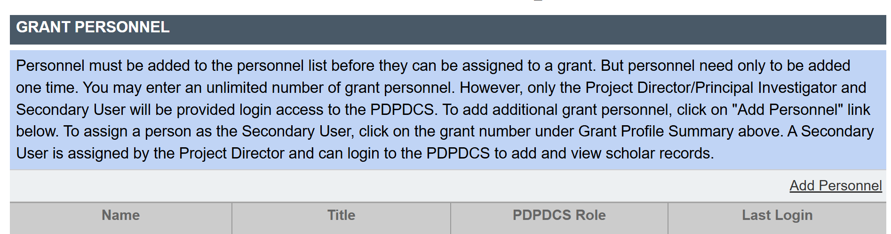
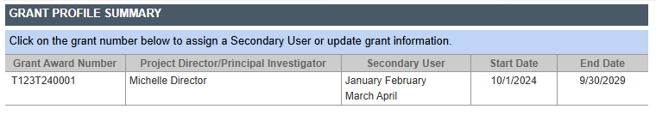

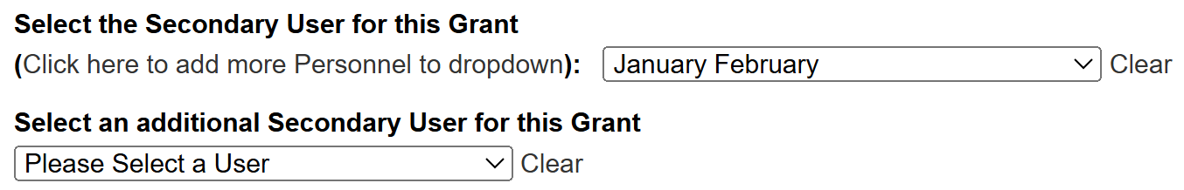
Adding a Secondary User
Click on Add Personnel to add an account for a secondary user.
Click on your grant award number to change your secondary user(s).
Use the dropdown menus to select secondary users.

Slide 9
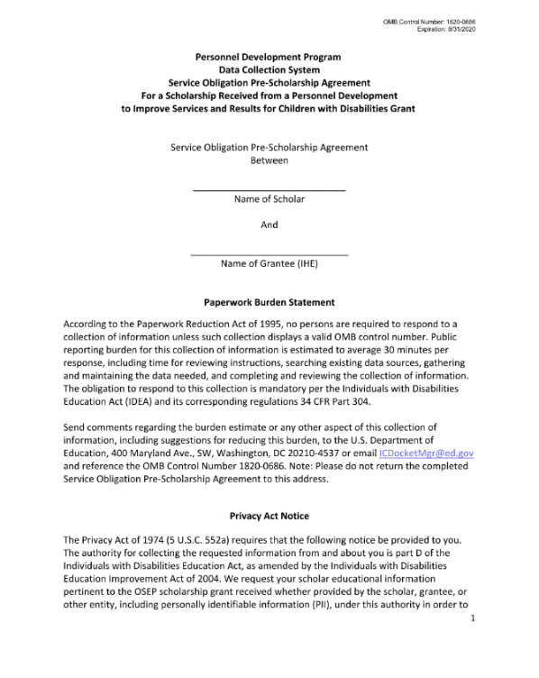
Pre-Scholarship Agreements (PSA)
Grantees and scholars must sign an OMB-
approved PSA for each funded scholar
  Scholar records cannot be created without a PSA
Grantees may be held responsible for funds
provided to scholars with missing or invalid
documents
Grantees must retain all grant records (incl.
PSAs) until each scholar’s service obligation
has been fulfilled or paid back

Slide 10

Issues with PDF Upload PSAs
Missing or invalid project director signature
Missing or invalid scholar signature
Missing grant information
Missing pages
Uploaded to incorrect scholar record
Valid signatures must be:
Signed in ink or
Signed with a legal digital signature software (e.g., Docusign, Adobe Acrobat), and
In PDF format (not Word).

Slide 11
Timeline for Enrolling Scholars
Scholar enrolls in IHE
Scholar formally enrolls in program
Scholar receives OSEP funding
Scholar graduates/ exits the program
Scholar begins classes
Scholar signs PSA
Grantee submits scholar record

Slide 12

Creating New Scholar Records
New OSEP PDPDCS scholars must have:
  Received OSEP PDPDCS funding
  Enrolled in the IHE’s training program
  Registered for classes
  Signed the PSA
Once a scholar completes these steps, grantees have 30 days to create and submit their scholar record
No simultaneous enrollment in multiple grants is allowed

Slide 13
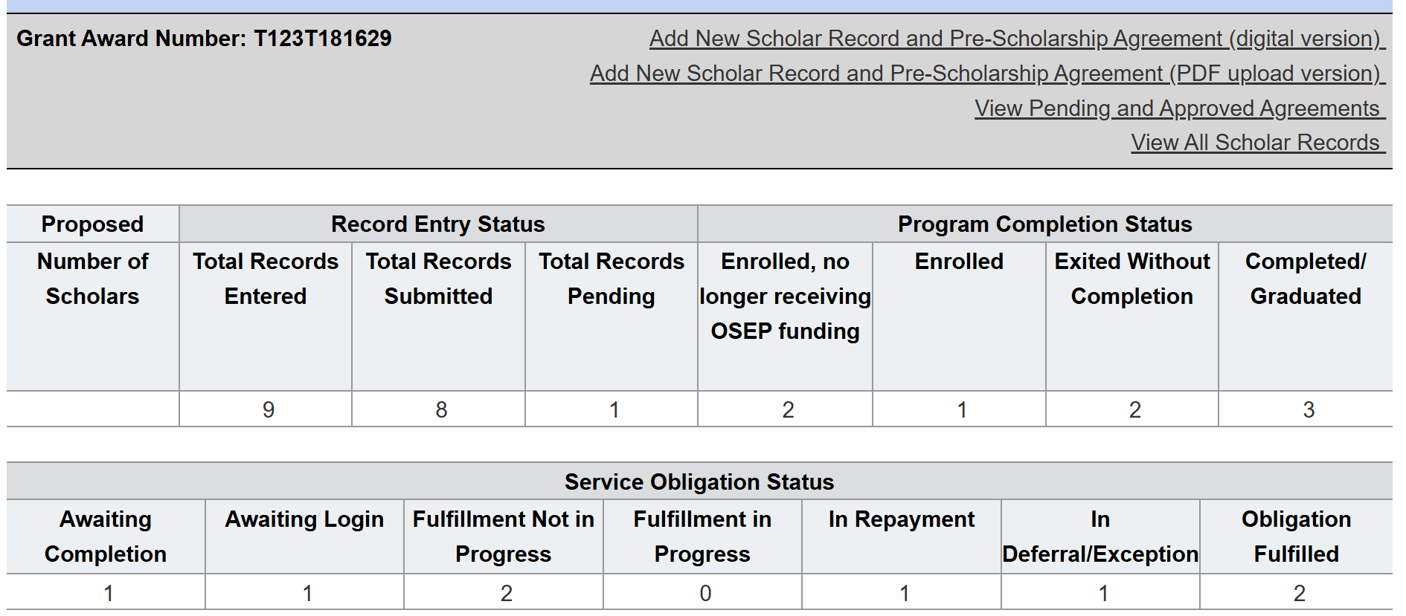
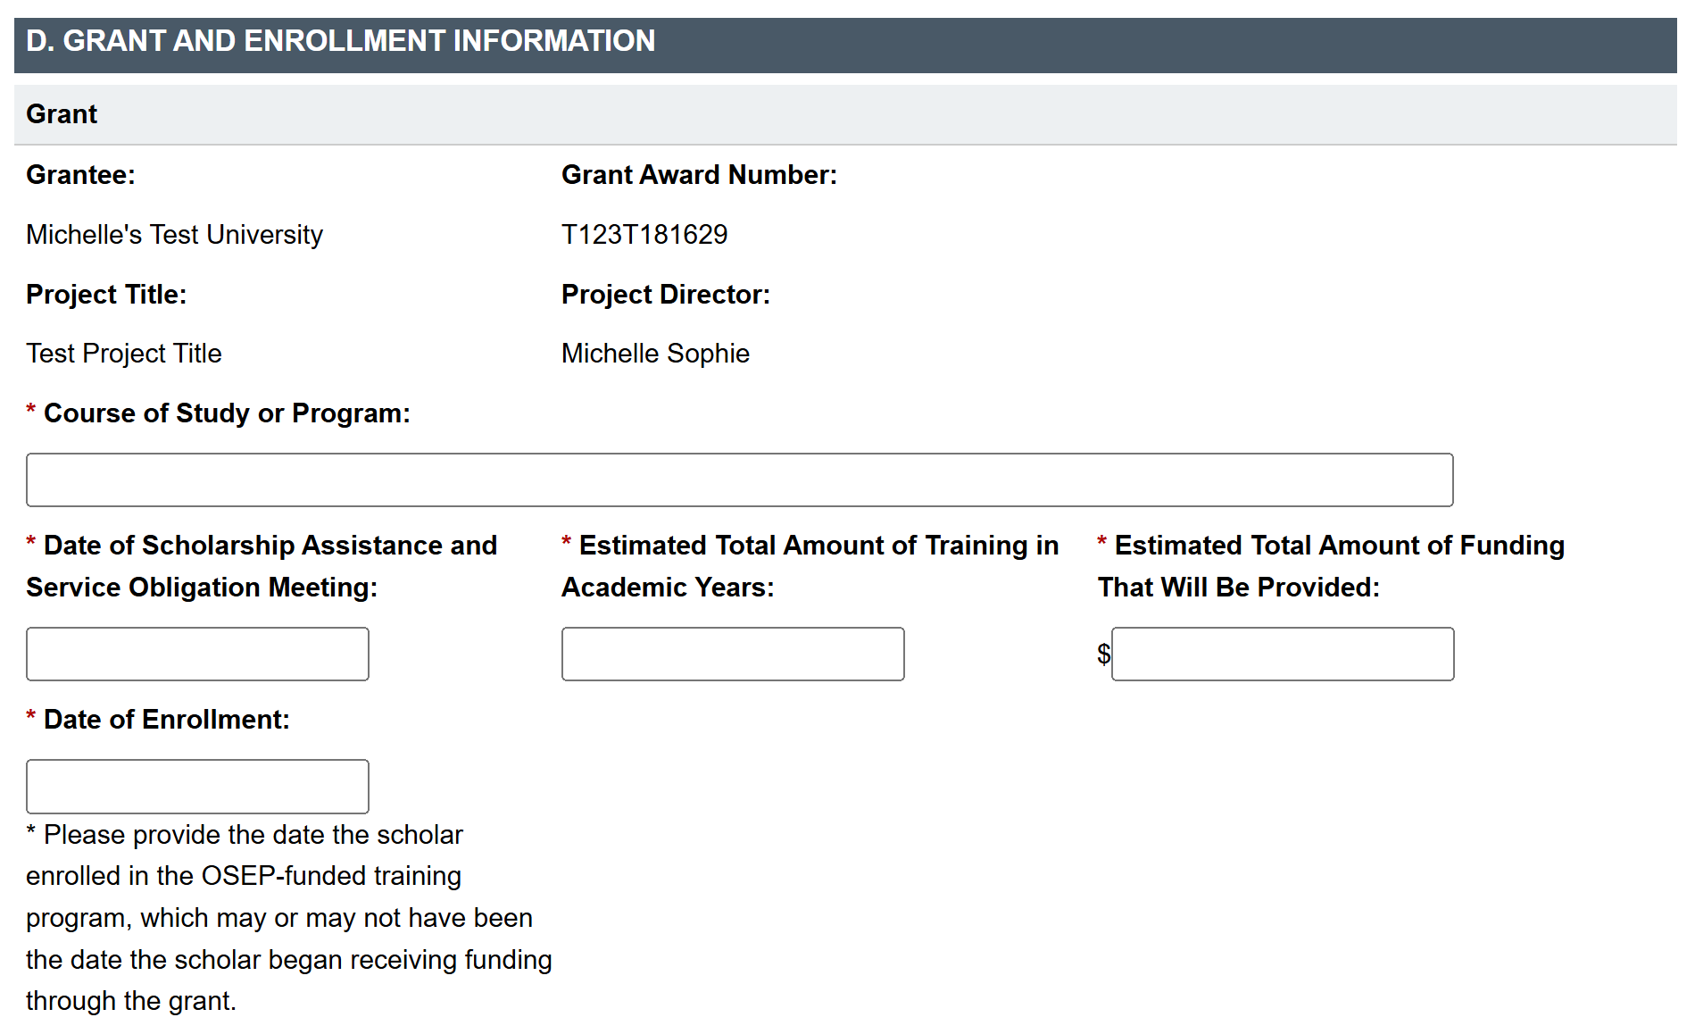
Submitting New Scholar Records

Slide 14
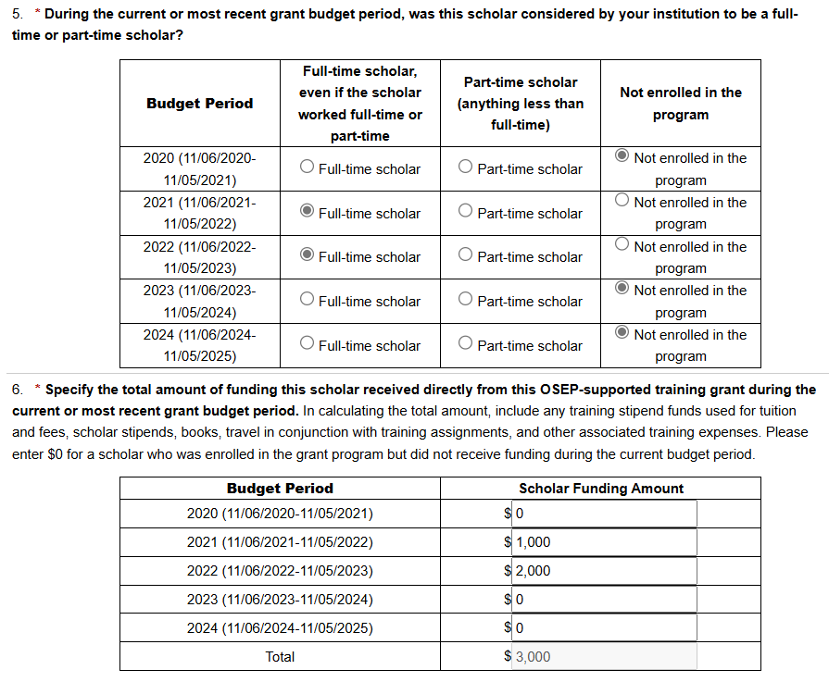
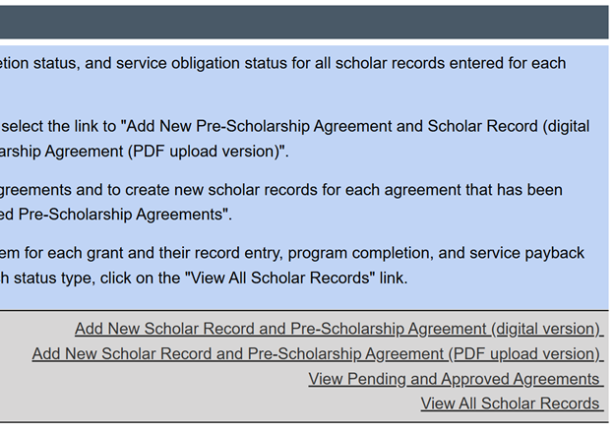

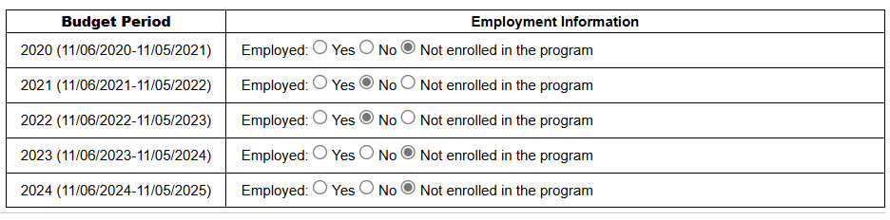
Updating Enrolled Scholar Records
Review contact, demographic, training, and previous employment information in sections A-F
Update full- or part-time enrollment status and OSEP funding received in section G numbers 5 and 6 and current employment information in section H
  Scholar enrollment status each year needs to match
Update program duration and academic years of funding completed in section I numbers 2 and 3

Slide 15
Program Completion Statuses
Enrolled
Enrolled, No Longer Receiving OSEP Funding
Graduated/Completed
Exited without Completion

Slide 16
Pending Scholars
OSEP requires that scholars are in a pending status for no more than 30 days
Help Desk staff will contact you and your Project Officer if your grant has scholars in a pending status at the end of each annual data collection period

Slide 17
Managing PDPDCS Grant Timelines
Project Directors must manage grants to ensure that:
All scholars complete the program before the grant ends
Scholars are enrolled early (Year 1) with sufficient time, funding, and support to complete the program
The number of scholars proposed, enrolled, and completed meets outlined expectations
Contact your OSEP Project Officer to discuss any changes to the expected number or completion status of scholars

Slide 18

Submit Data for ALL Scholars by March 13
  Federal Regulations:
  According to 34 CFR 75.253(a)(3), the timely
  submission of this report is one of the
  factors that the Secretary will consider in
  determining whether to continue your
  project's funding for the next fiscal year
  According to section 75.217(d)(3)(ii), the Secretary can consider the failure to submit scholar data in a timely fashion in determining your project’s ability to obtain future grants from the Office of Special Education Programs or under any other Department program

Slide 19
Exiting OSEP Scholars

Slide 20
Issues with PDF Exit Certifications (ECs)
Missing or invalid PD and/or scholar signatures
Uploaded to incorrect scholar record
Does not match data in scholar record (e.g., program
length, date of completion, funding received, etc.)
Your IHE must maintain paper copies of all agreements until all scholars have completed their obligations, even if you leave the university.

Slide 21
Steps for Exiting Scholars
Complete all steps within 30 days of each scholar’s exit or graduation date, or within 30 days of the grant end date if the grant will end before the scholar exits.
Step 1: Ensure all information in Sections
A – I is accurate
Step 2: Complete digital EC or upload PDF EC
Step 3: Enter scholar exit information in Section J, if applicable
Step 4: Save and submit scholar record
Exit Certification Form

Slide 22
Demonstration:
Exiting Scholar Records

Slide 23
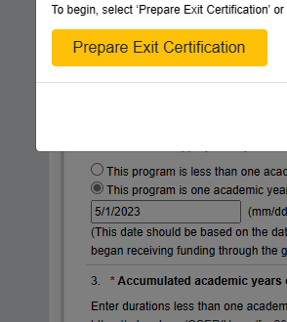
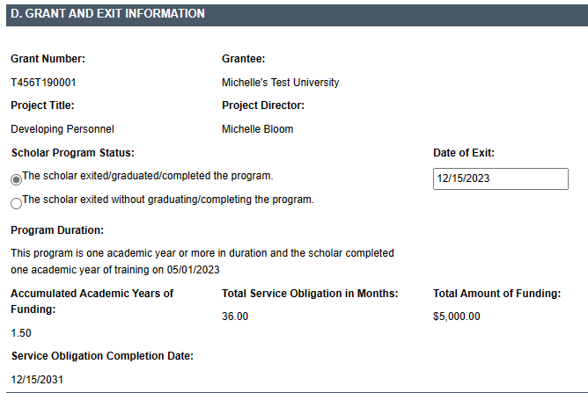
Digital EC Process
Scholars are not considered exited until the EC has been signed AND the scholar’s record has been submitted.

Slide 24

Measure of Knowledge and Skills
Completed/graduated scholars are required to fulfill a measure demonstrating knowledge and skills in evidence-based practices for children with disabilities.
Options for measures:
    Grantee-specific tests (e.g., portfolio, comprehensive exam, dissertation defense)
    PRAXIS II
    National organization tests
    State-specific tests
    Capstone project or exam

Slide 25
Example Measures
Completed/graduated scholars are required to fulfill a measure demonstrating knowledge and skills in evidence-based practices (EBPs) for children with disabilities.
ACCEPTABLE Measures | UNACCEPTABLE Measures
Grantee-specific tests (e.g., portfolio, comprehensive exam, dissertation defense) PRAXIS II National organization tests State-specific tests Capstone project or exam required of scholars prior to degree program or grant project completion | Entrance exams (e.g., PRAXIS I, GRE, SAT) University preliminary exams Individual course exams or grades

Slide 26
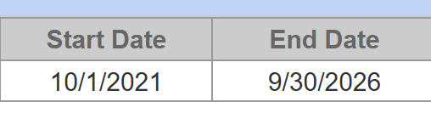
Exit All Scholars BEFORE Your Grant Ends
Any scholar who has not graduated/completed or previously exited when a grant closes will be “exited without completion.”
  Select “OSEP support terminated due
  to OSEP grant ending” as the reason the
  scholar is no longer enrolled.
Project Directors are responsible for
submitting digital or PDF upload ECs from these scholars into the PDPDCS. Service obligation requirements still apply.
All scholars must be exited before submitting your Final Performance Report.

Slide 27
Responding to Data Quality Emails
Pending Scholars
Submit any scholar records that are “saved for later”.
Scholars Submitted Before Enrollment Date
Do not submit any scholars before they have officially enrolled in the program.
Grants with Zero Scholars
After the planning year of your grant (year 1), you must have scholars submitted and enrolled.
Scholars Enrolled in Closed Grants
Exit any scholars still enrolled and ensure their ECs are signed and completed and submit the scholar record.

Slide 28
Avoiding Security Incidents

Slide 29

Security Incidents
A security incident occurs if personally identifiable information (PII) is potentially viewable to unrelated parties.
Examples from PDPDCS:
  Uploading an unredacted Pre-Scholarship Agreement (PSA) to the wrong scholar record
  Sending unencrypted documents (Social Security Card,
  Driver’s License, etc.) in an email to the PDPDCS
  Help Desk

Slide 30
Impacts of Security Incidents on Department Staff
PDPDCS staff must notify the Department’s Education Security Operation Center (EDSOC), document the incident, and expunge the file or email from the servers.
Additional interviews, investigations, and mitigation strategies may be necessary.
PDPDCS staff must review all other scholar records and documentation associated with the grantee.

Slide 31
Impacts of Security Incidents on Grantees
Grantees must resubmit scholar documentation, complete a security incident report, and participate in investigation interviews as needed.
Project Directors and Secondary Users will be required to participate in a security training to understand the proper handling of scholar PII and the consequences of data breaches.
The grant will be placed on a security incident list tracked by PDPDCS and OSEP staff. If further incidents occur, the grant and university could be placed on high-risk status, impacting their ability to receive future federal funding.

Slide 32
Scholar FAQs

Slide 33
What reminders should I provide to scholars?
They must complete at least one full academic year of training before they may begin to fulfill their service obligation.
Log in to the system to update contact information and employment information every 6 months.
They must repay the amount of scholarship assistance not satisfied through eligible employment.
Scholar webinars and resources as well as FAQs are on the PDPDCS.
Read all emails from serviceobligation@ed.gov and contact the OSEP PDPDCS Help Desk for support.

Slide 34

When should scholars log in?
Scholars must login to the PDPDCS within 30 days of receiving access to the system
Scholars should continue to login every 6 months until they fulfill their service obligation to:
  Review and update contact information
  Review training and service obligation information
  Submit employment information

Slide 35
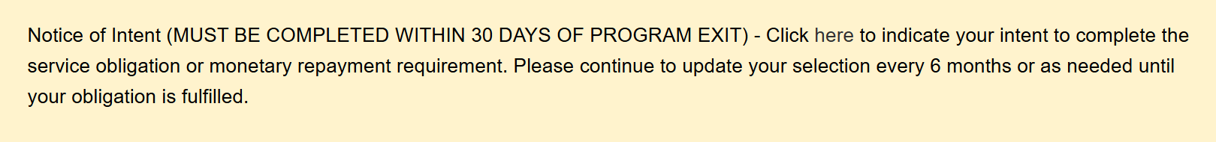
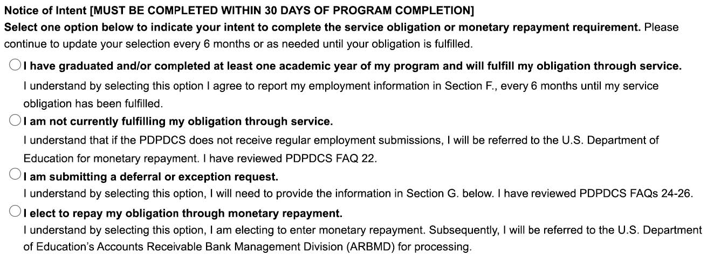
What is the Notice of Intent question?
New question for exited or completed scholars
Select from four options:
  Fulfilling through service
  Not currently fulfilling through service or using grace period
  Submitting deferral
  Repaying monetarily

Slide 36

What if scholars don’t get employment verification?
Scholars are responsible for ensuring their submitted employment is reviewed and verified by their employer
Scholars who do not have their employment verified by the time their service obligation must be fulfilled will be referred for monetary repayment
Future employment credit cannot be calculated in
the system – employment is credited up until the day
the record is verified by the employer

Slide 37
Resources and Support

Slide 38
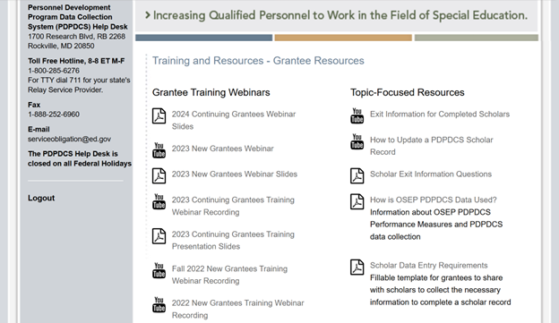
Finding PDPDCS Resources
PDPDCS resources include:
  Annual and Final Checklists
  Digital PSA and EC info
  Scholar Webinar recordings
  Update a Scholar Record Demo
  Multifactor Authentication info
PDPDCS Frequently Asked Questions:
  Regulatory FAQs
  Data Collection System FAQs
pdp.ed.gov/OSEP/Home/GranteeTraining

Slide 39
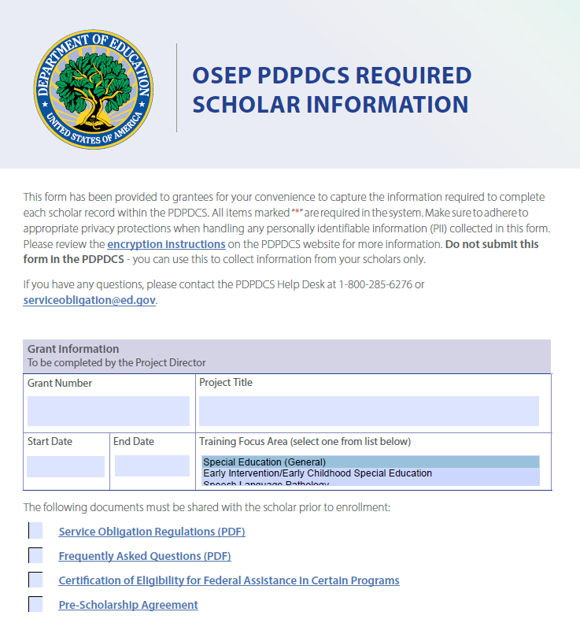
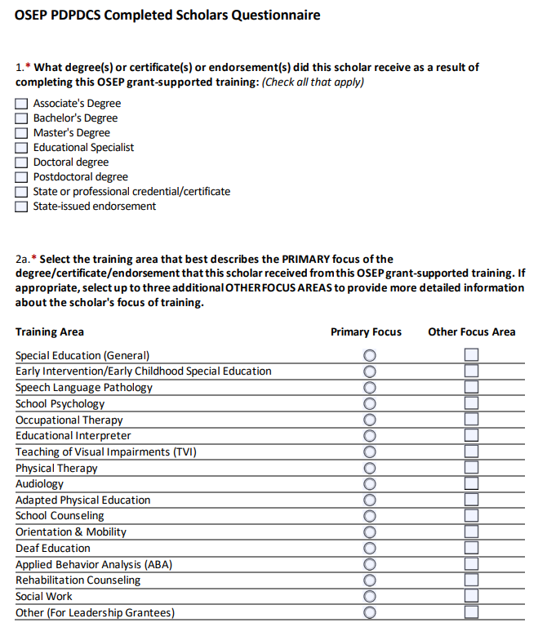
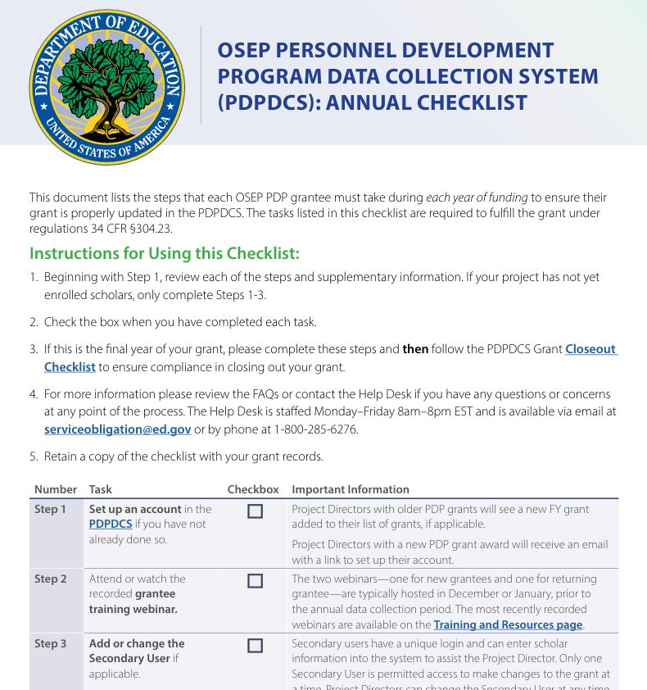
Recommended Data Collection Resources

Slide 40
Reminder: Please Exit Your Scholars!
Review and complete entire scholar record prior to changing scholar status.
Ensure your scholars SIGN THEIR EXIT CERTIFICATION.
Provide all documentation and grant information to any staff superseding you.

Slide 41
Thank You!
Please take the webinar survey: https://www.surveymonkey.com/r/X8K77WK
PDPDCS Help Desk
  Support available from 8 am to 8 pm EST
  Monday through Friday
  1-800-285-6276
  For TTY dial 711 for your state’s Relay Service Provider
  serviceobligation@ed.gov

